Slide 1
ISLEHAM IMPROVING OUR COMMUNITY FACILITIES

Slide 2
How we went from this

Slide 3
This

Slide 4
This

Slide 5
And This

Slide 6
T0 THIS

Slide 7
THIS

Slide 8
AND THIS

Slide 9
Isleham Our Village

Slide 10
Isleham Our Village
2300 people
On the Suffolk border on the edge of the Fens and geographically isolated
A thriving Co-op and a part time Post Office
3 Churches
3 Pubs
Pre School and St Andrew’s Primary School
Strong participation in local sport, thriving Youth Football
No Public Transport
1 small Business Park
Diverse Local Environment and Steeped in History

Slide 11
Isleham Our Village

Slide 12
The Priory

Slide 13
Need for New Facilities
Village Hall outdated, lacking facilities and capacity
Sports Pavilion dilapidated
Children’s play facilities ageing
No play provision for older children
Increased levels of participation in sport and fitness activities on the Rec

Slide 14
The Vision
Demolish Village Hall and Sports Pavilion
A New Community Centre with Sports Facilities
Relocate and provide new Children’s Play Area
Provide a Skate Park
Relocate the Multi Use Games Area(MUGA)
Relocate the Cricket Square
Relocate the Football Pitches
Increase the use of our Recreation Ground

Slide 15
The First Steps 2006 -2008
Discussions over improving Community Facilities approved by Parish Council
Village Questionnaire – clear support for new Multi Purpose Community Centre
Architects appointed
Initial estimate £2 million
Go ahead given to set up Isleham Community Association to act for the Parish on the Community Centre
Fundraising Team established, Grants, Donations, Fund Raising Activities
Parish Council earmarks monies from Land Sale for the project
Revising of Plans to reduce costs

Slide 16
Moving Forward 2009 -2012
Planning Approval for the Centre obtained
First Successful Grant Application
MUGA moved to provide space for new Centre
Action Group set up to raise funds for a Skate Park
Costs revised to £1.6million
Business Pan for Centre approved
Failed Big Lottery Bid at final hurdle
Further cost savings identified. Centre Costs revised to £1.4 million
Works tendered Parish Council agrees to take a loan for £500,000 over 25 years following public consultation

Slide 17
Nearly There 2012 - 2013
S106 monies + 2 further Grants to reach target build costs
CJ Murfitt of Soham appointed as Contractors
Final approval from Parish Council, Start on Site Dec 2012
Area of Rec earmarked for Skate Park
Review of funding for new equipment for Children’s play area
Parish Council takes a 2nd Loan of £100,000 for additional Play Equipment and Skate Park
Community Centre completed December 2013
Cost of Build £1.4 million + £100,000 for the Play Area and Skate Park

Slide 18
What has been achieved
A fully accessible building with Solar Panels and large Parking Area
Multi Use Hall and stage for up to 240 people seated
Kitchen
2 Meeting Rooms
Café/Bar
4 Sports Changing Rooms and 2 Changing Rooms for Officials
Office Accommodation for the ICA
Office Accommodation for the Parish Council
New Play Area
Skate Park

Slide 19
The Skate Park

Slide 20
The Play Area

Slide 21
THE BEECHES

Slide 22
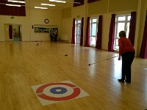
Our Hall

Slide 23
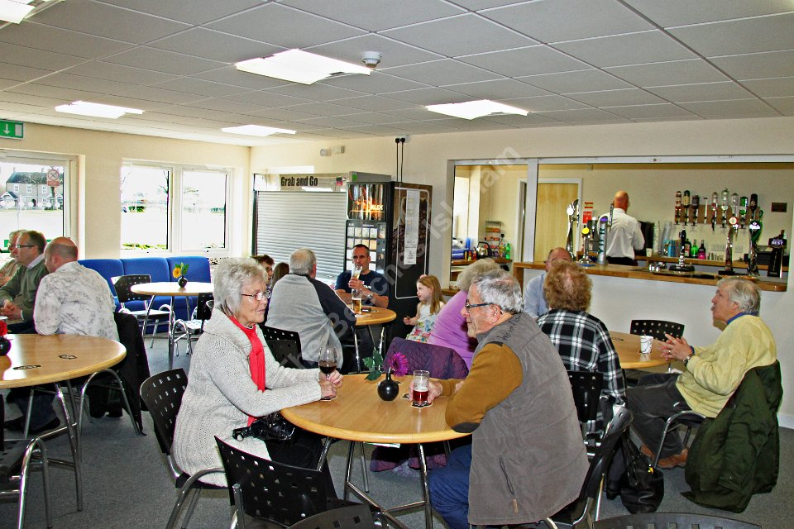
Café / Bar

Slide 24
Kitchen

Slide 25
MEETING ROOMS

Slide 26
FUNDING
Donations
Fund Raising
Grants
Receipts from Land Sale
Section106 Monies
Parish Council Reserves
Loan from Public Works Loan Board

Slide 27
Costs
Parish Council maintains the fabric of the building, The Beeches, and leases it to the ICA
ICA charges users with preferential rates for Village Groups and Residents
Parish Council retains responsibility for the Rec and other facilities
The Beeches operating on a Break Even basis
Parish Council Precept £95k pa, including loan repayments
Parish Council repayments for PWLB loan = £38k pa
Cost of Loan repayments per dwelling = 70p per week

Slide 28
Learning
Value of a clear vision and continued commitment to it
Build and Evidence Community Support
Strong and dedicated Volunteers with lots of energy
Be prepared for set backs
We still need to:
Surface the Car park
Develop a garden and
Encourage even greater use of the facilities

Slide 29
The Benefits
A Building and Facilities Accessible to All
Owned by the Parish Council and managed by the Isleham Community Association
Run by paid and volunteer staff
Operating on a break even basis
A venue catering for large and small Receptions, Parties and Events
A good space for Village Groups, Organisations and Individuals to meet
Increased number and range of activities available and maintained
Higher levels of participation in village activities
Improved play facilities for the younger local people

Slide 30
