Slide 1
Project to remodel and extend Soham Pavilion
By
Rosemary Aitchison
Soham Town Council

Slide 2
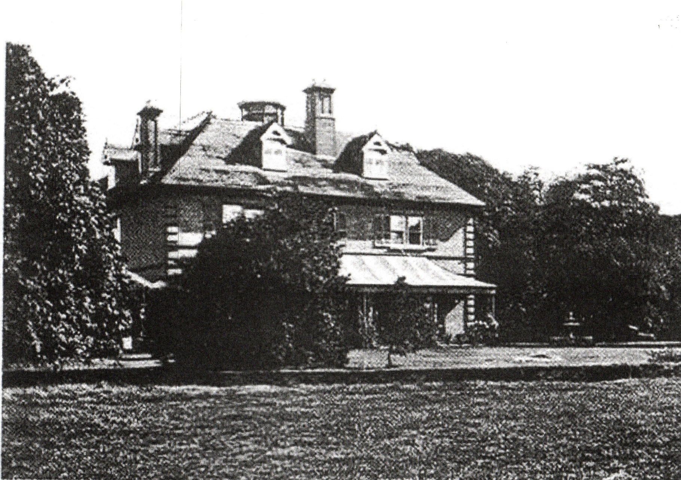
Side view of ‘The Place’
Sold to Soham Town Council in 1929

Slide 3
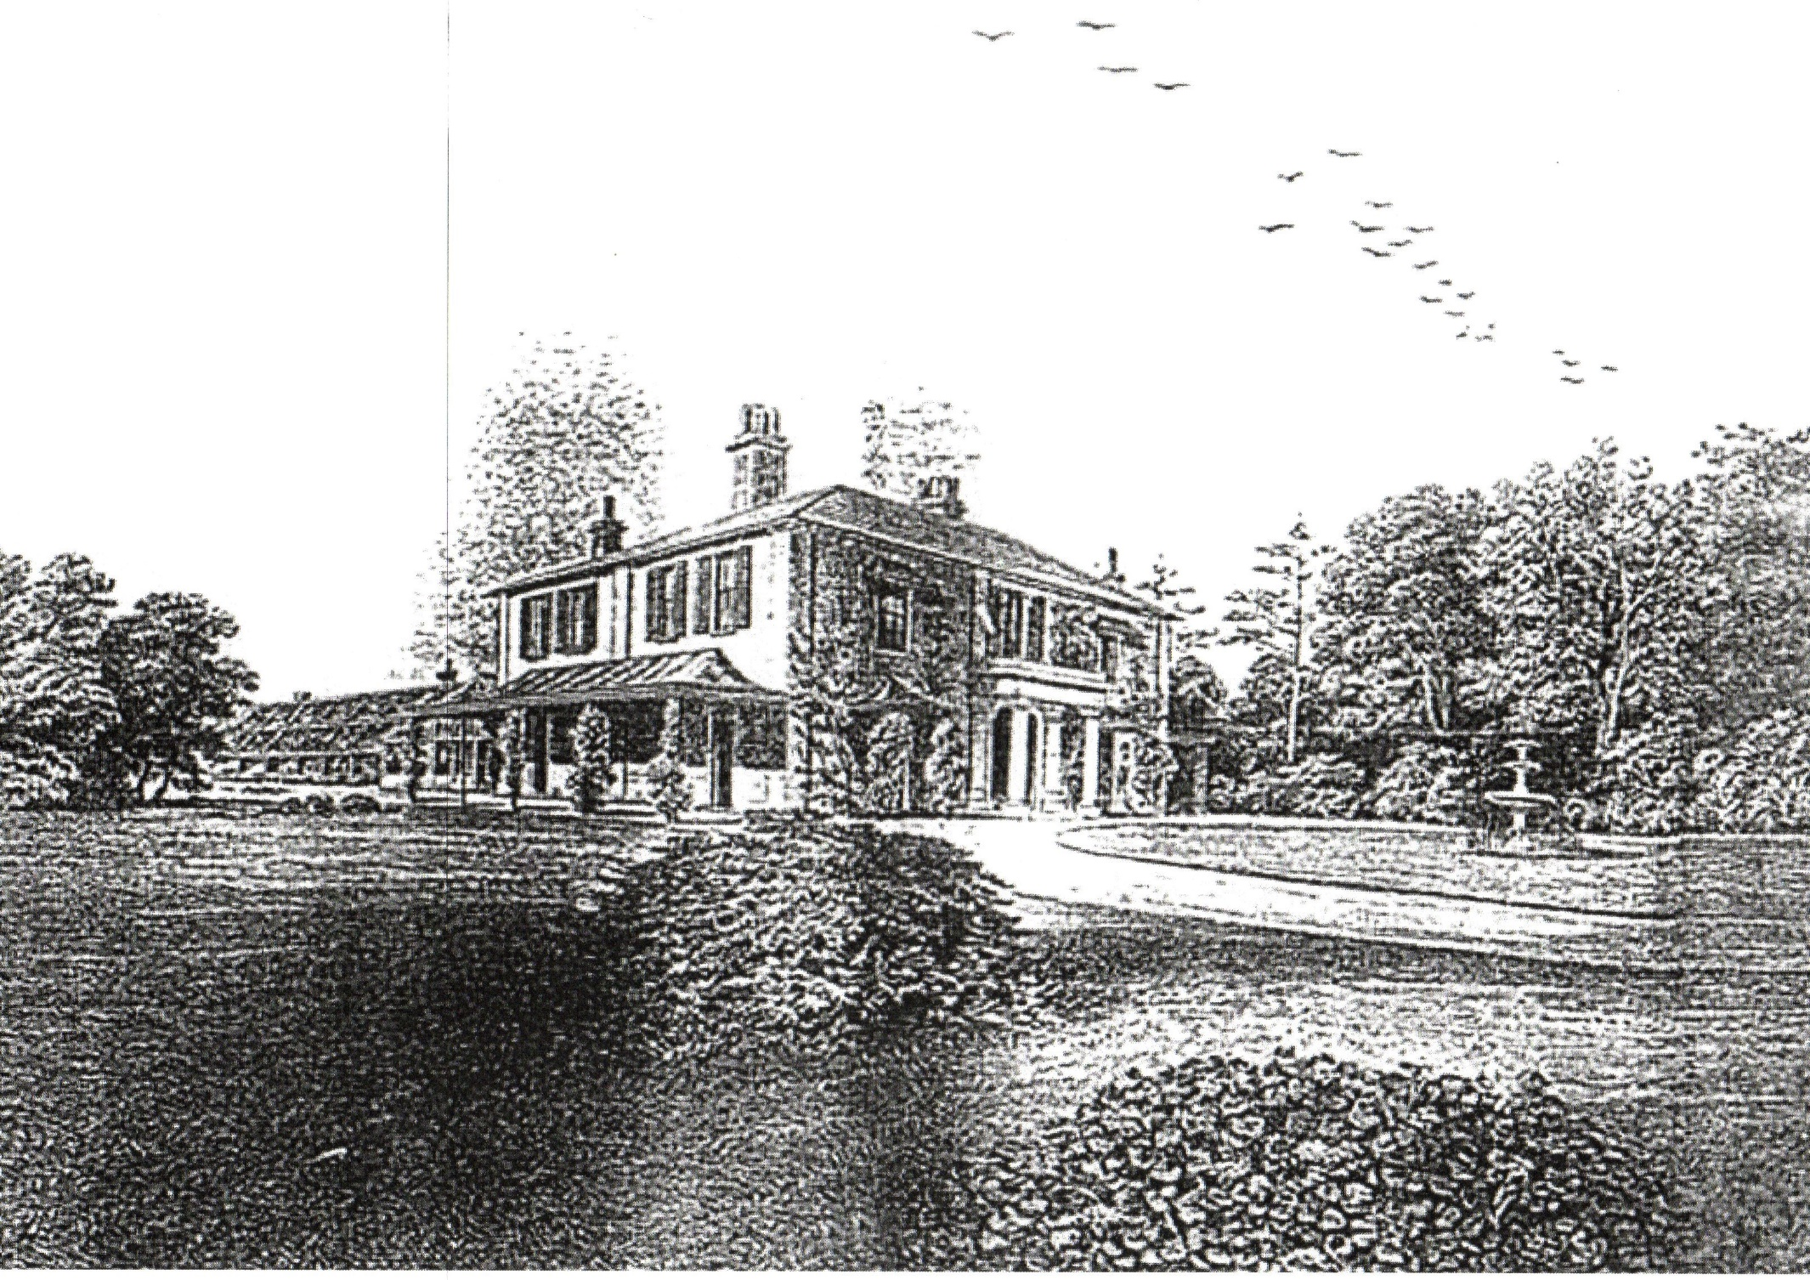
Pen and ink drawing of the front and side of ‘The Place’ showing the veranda

Slide 4
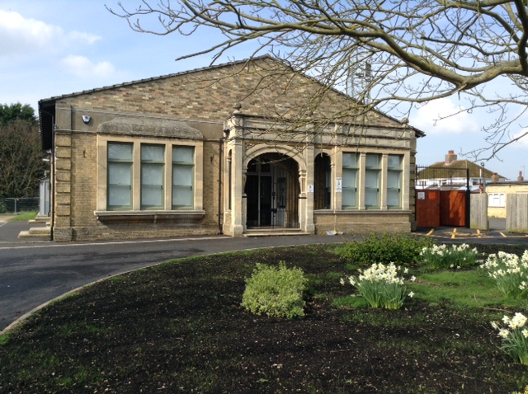
Walter Gidney Pavilion, Soham
As it has looked since the Town Council took it over

Slide 5
In late 2007 we had a Community Facilities Audit on local rooms and halls suitable for hire to community groups when extensive local consultation was carried out.
The results presented to the Town Council clearly indicated that Soham was lacking in halls which could be rented at a reasonable rate.
Also we discovered that a piece of land owned by the Town Council may be coming forward for development and could provide a useful pot of money

Slide 6
When embarking on a project like this there are a number of steps which have to be carried out
Consult the community
Council must decide what they want
Instruct an architect
Approve the plans and estimated cost
Seek funding
Seek planning permission
Prepare brief for tendering
Select Contractor
Start build
Iron out snags
Project completed

Slide 7
It turned out not to be quite as simple as that for our project.
It has taken from 2008 to 2017 to complete only Phase One of our project because of a number of problems encountered along the way.

Slide 8
The Council took time to discuss and consult on what was wanted
Build a new hall which would seat between 120 to 160 people
Provide appropriate storage space
Remodel the front Pavilion building updating the office space and providing a suitable room for a Council Chamber together with appropriate IT systems
Remodel the access to the Pavilion from the Fountain Lane car park including providing a safe, well lit pedestrian access
Use local firms where possible

Slide 9
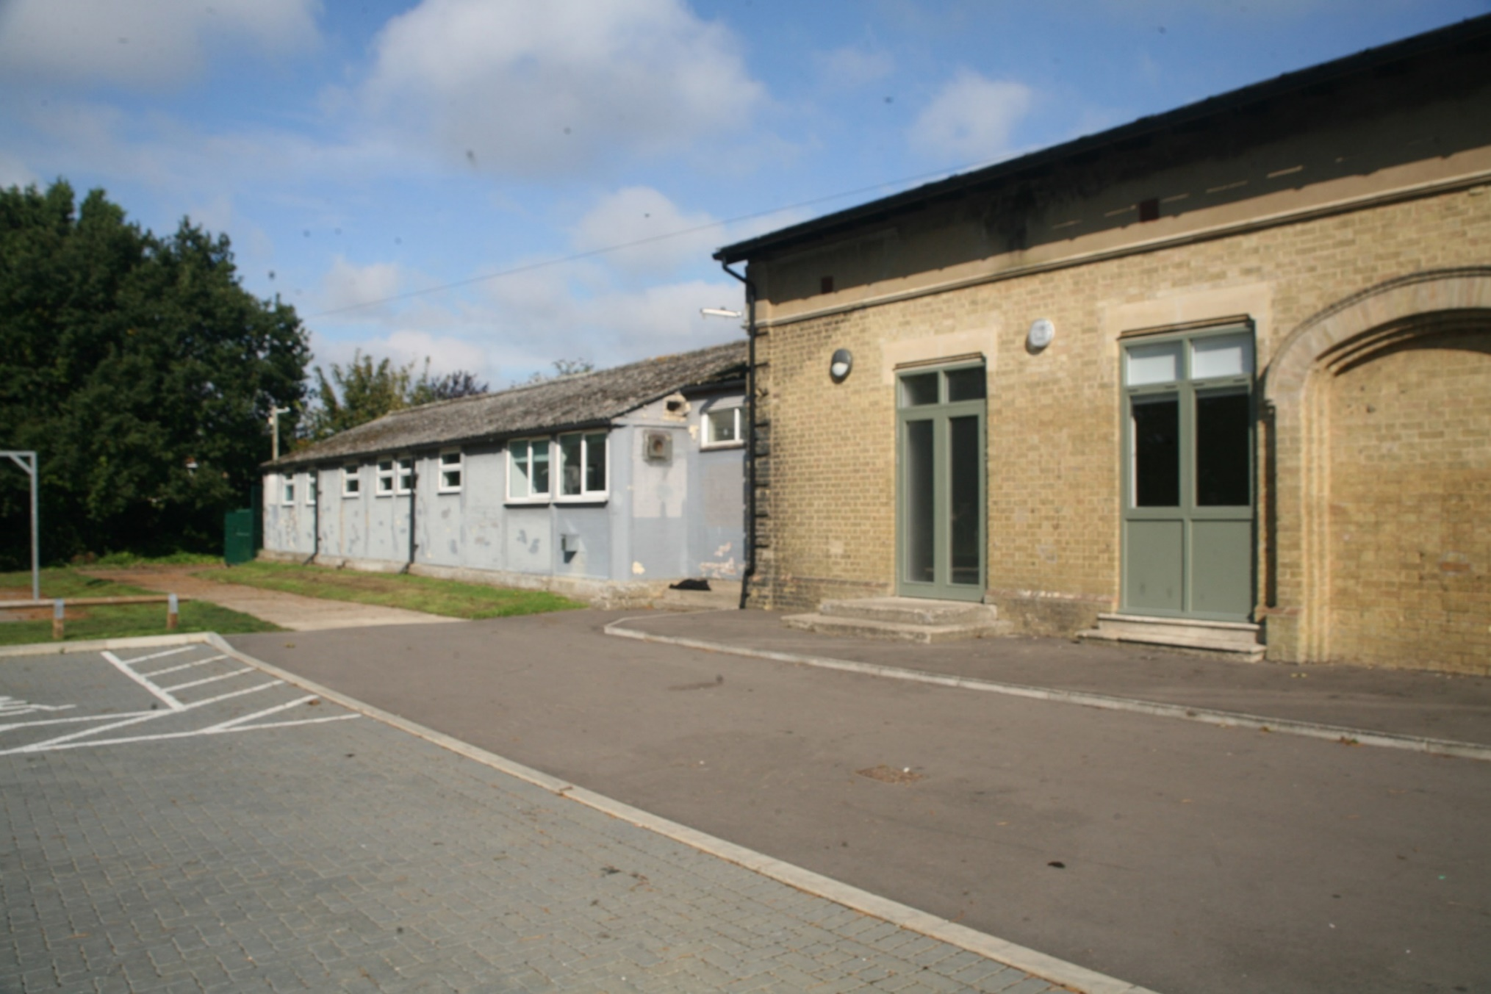
Side view of the building showing ‘prefab’ building at the back

Slide 10
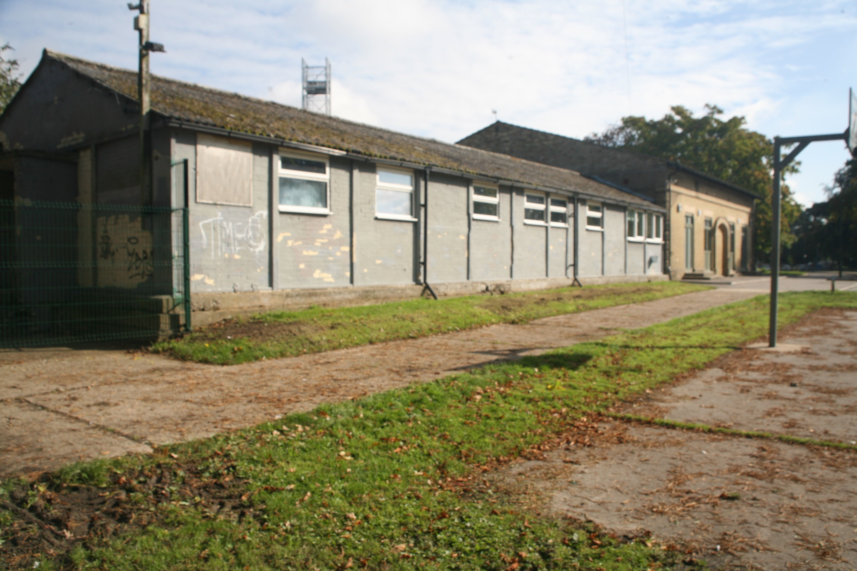
Additional view of the back building behind which is the tractor shed and fuel tank

Slide 11
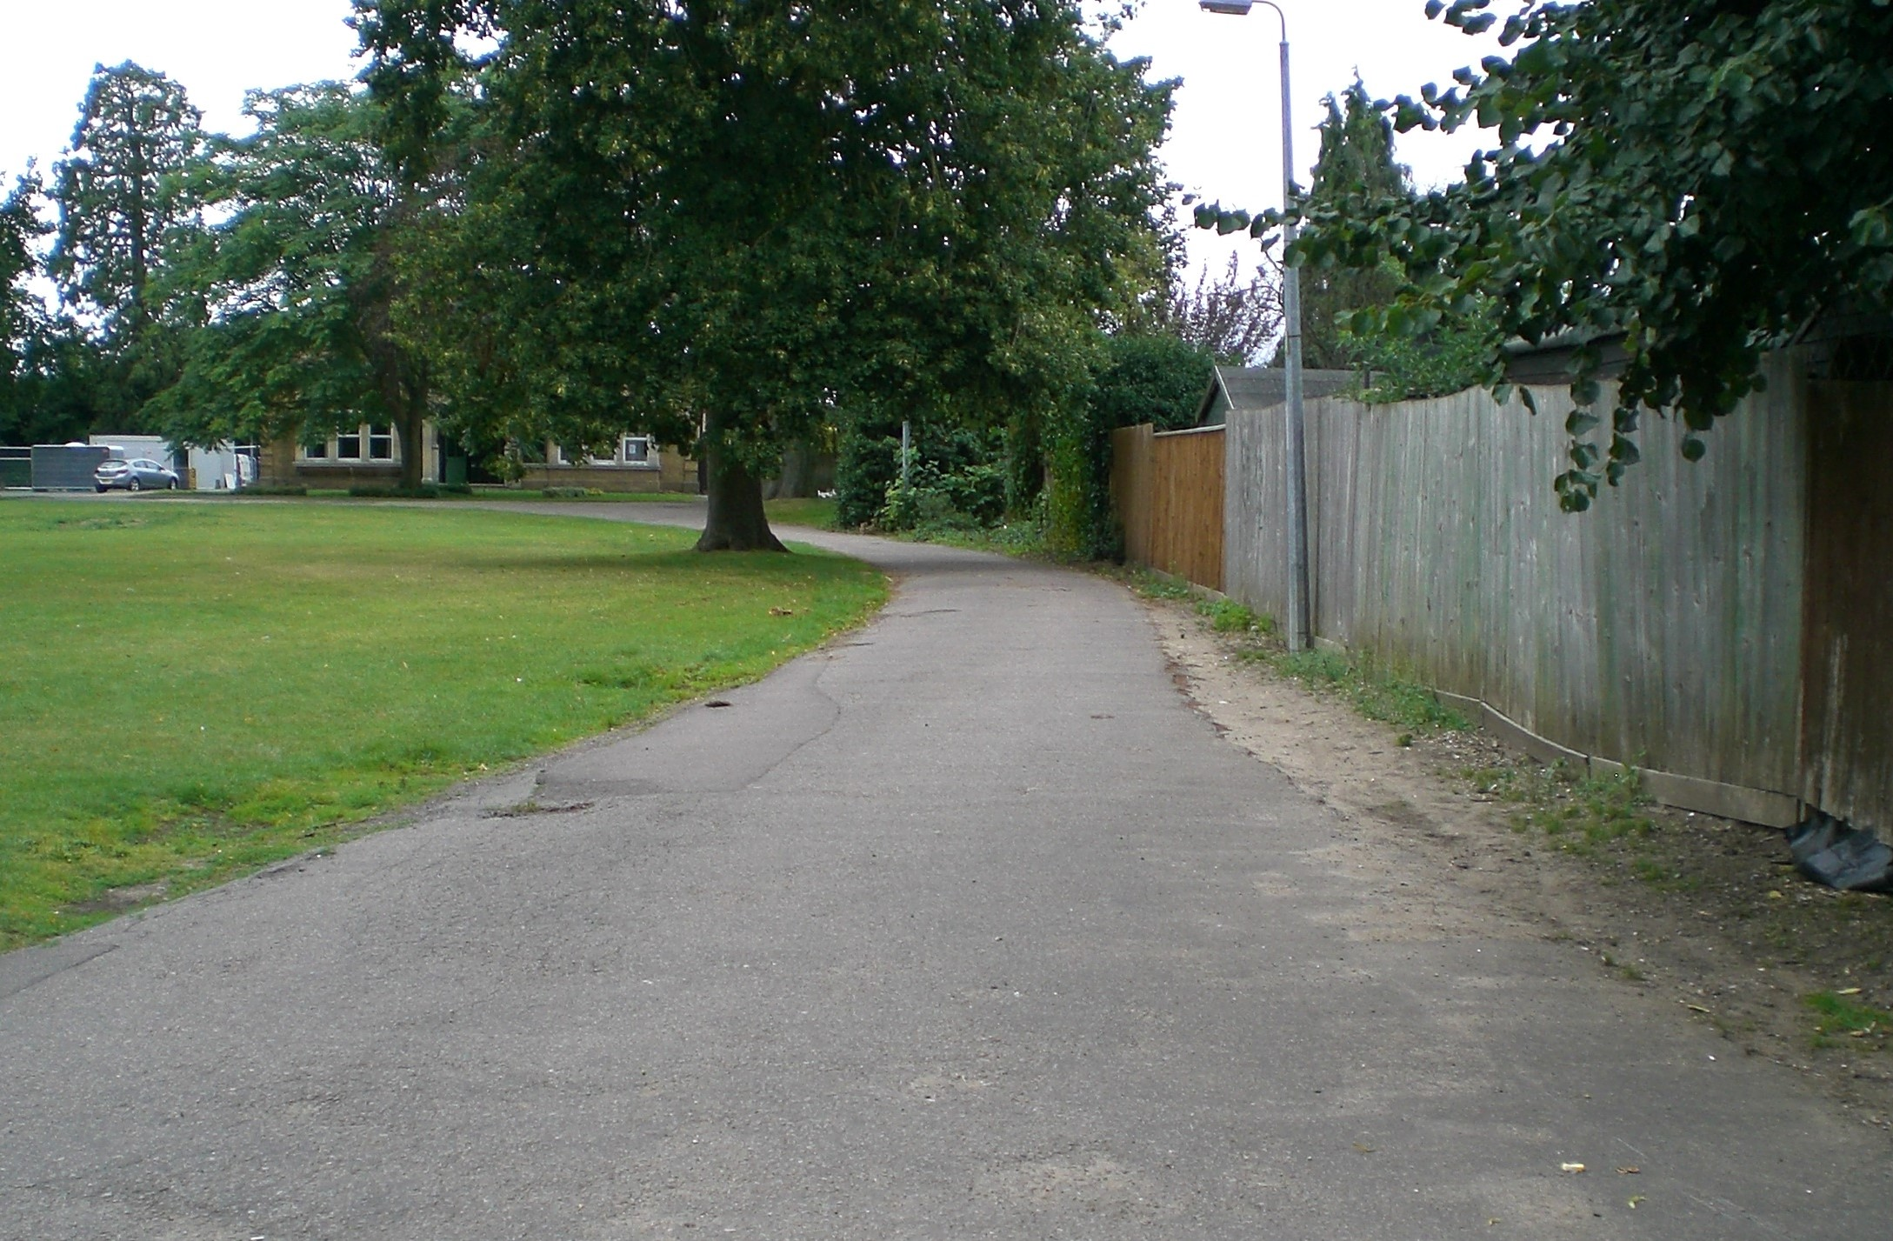
Roadway to the Pavilion across the Recreation Ground which is lit but has no footpath

Slide 12
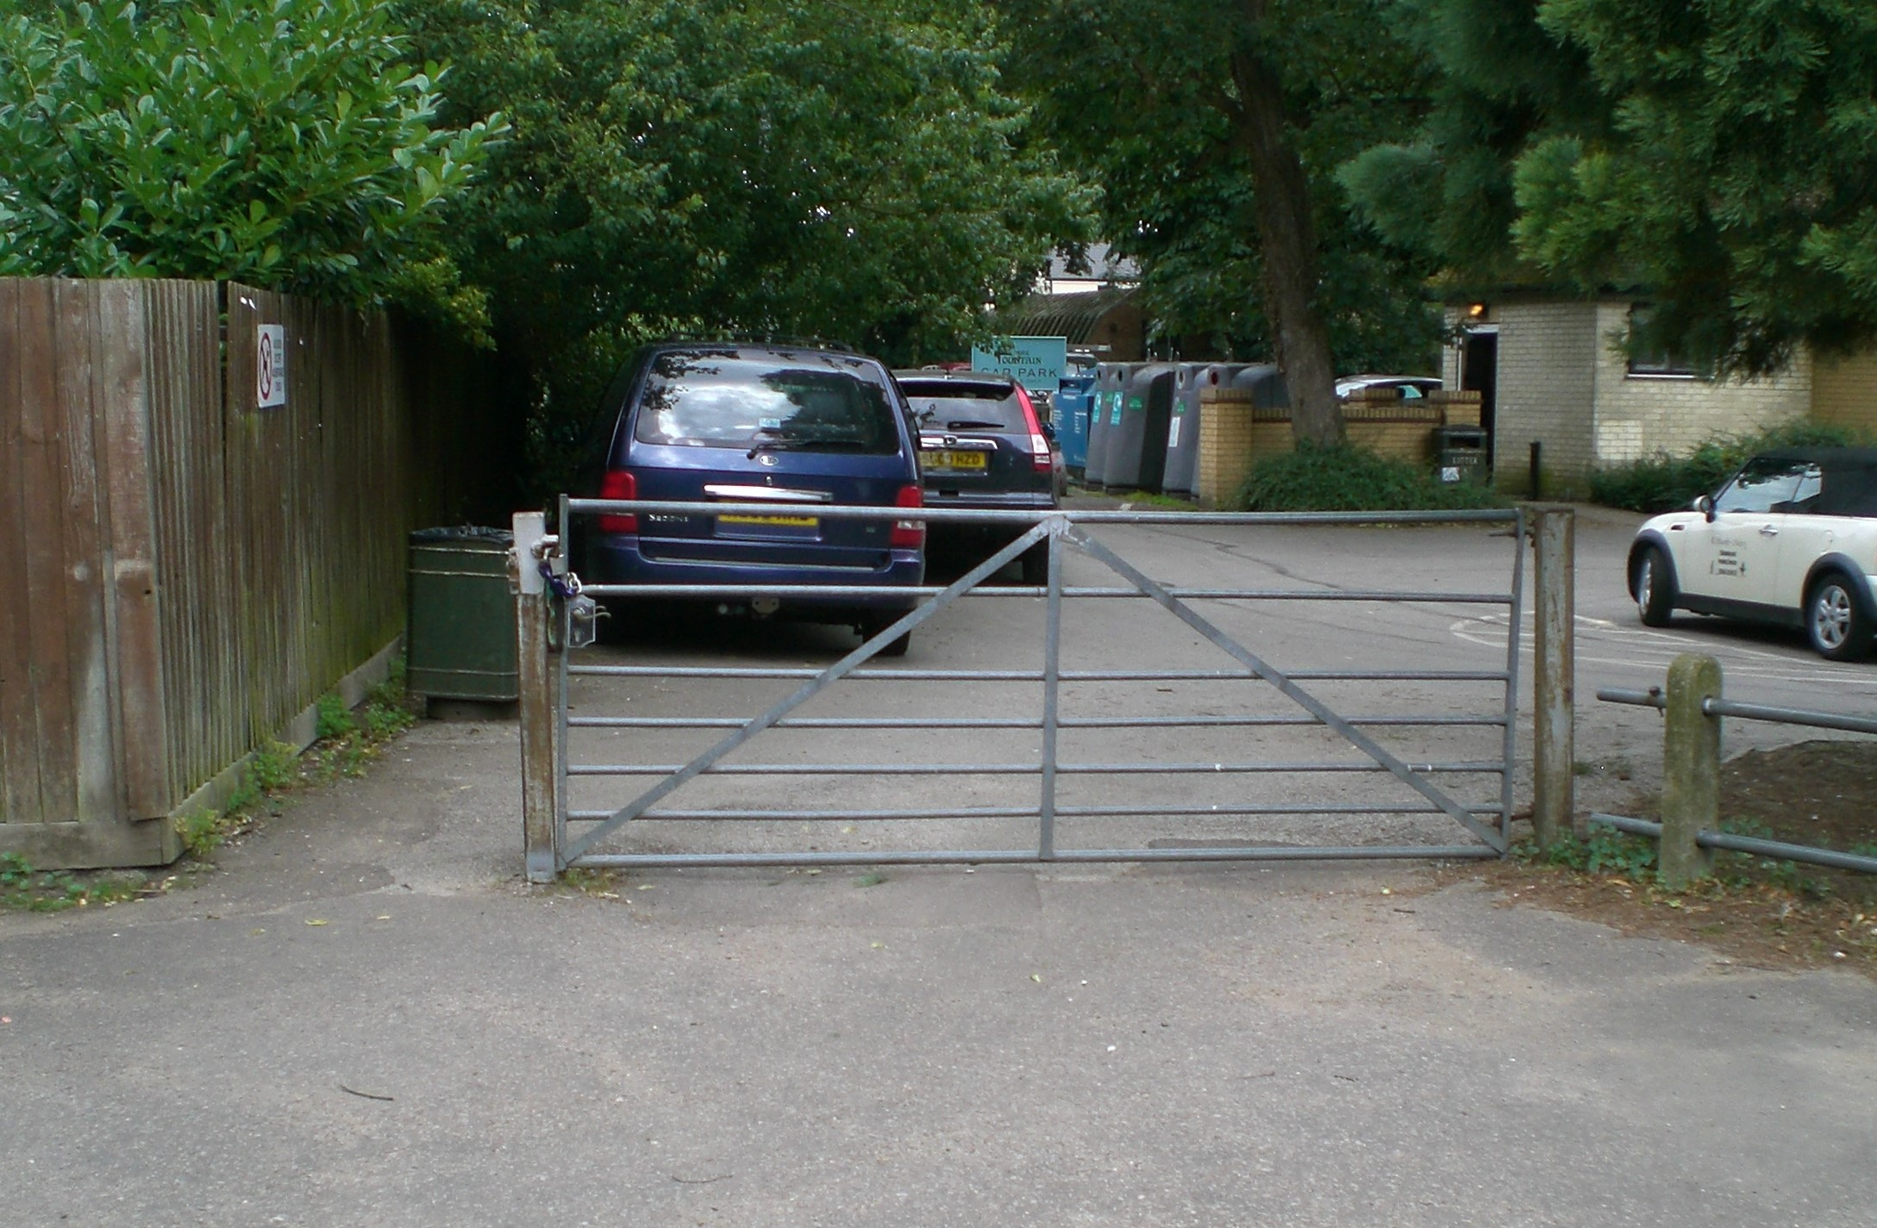
Poor access for both vehicles and pedestrians

Slide 13
We prepared a brief from our discussions which would inform a feasibility study.
This was sent to three local firms of architects who had been recommended to us
They were asked to reply by July 2008

Slide 14
We finally chose the design suggested by Archial whose architect was George Wright.
The plans included keeping some of the special interior features in the Pavilion. The access to the Recreation Ground and the car parking would also be improved.
The cost of the feasibility study was £50k and the estimated cost for the project was £1.4million

Slide 15
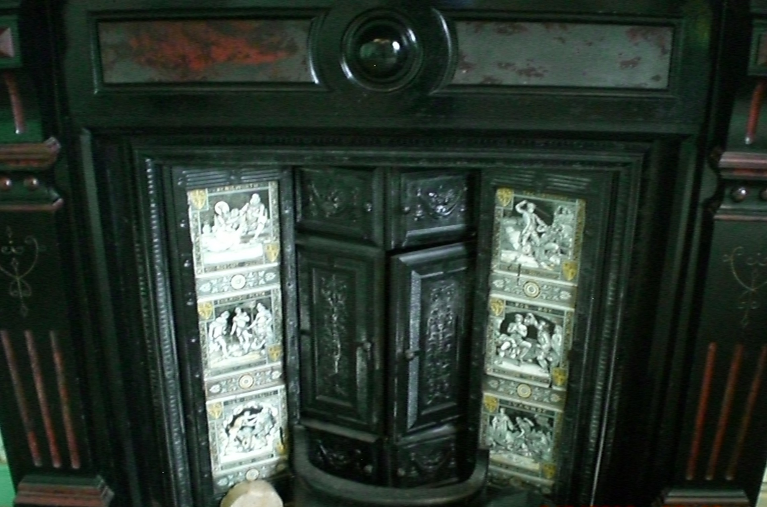
Lovely tiled fireplace in what was our Council Chamber /office

Slide 16
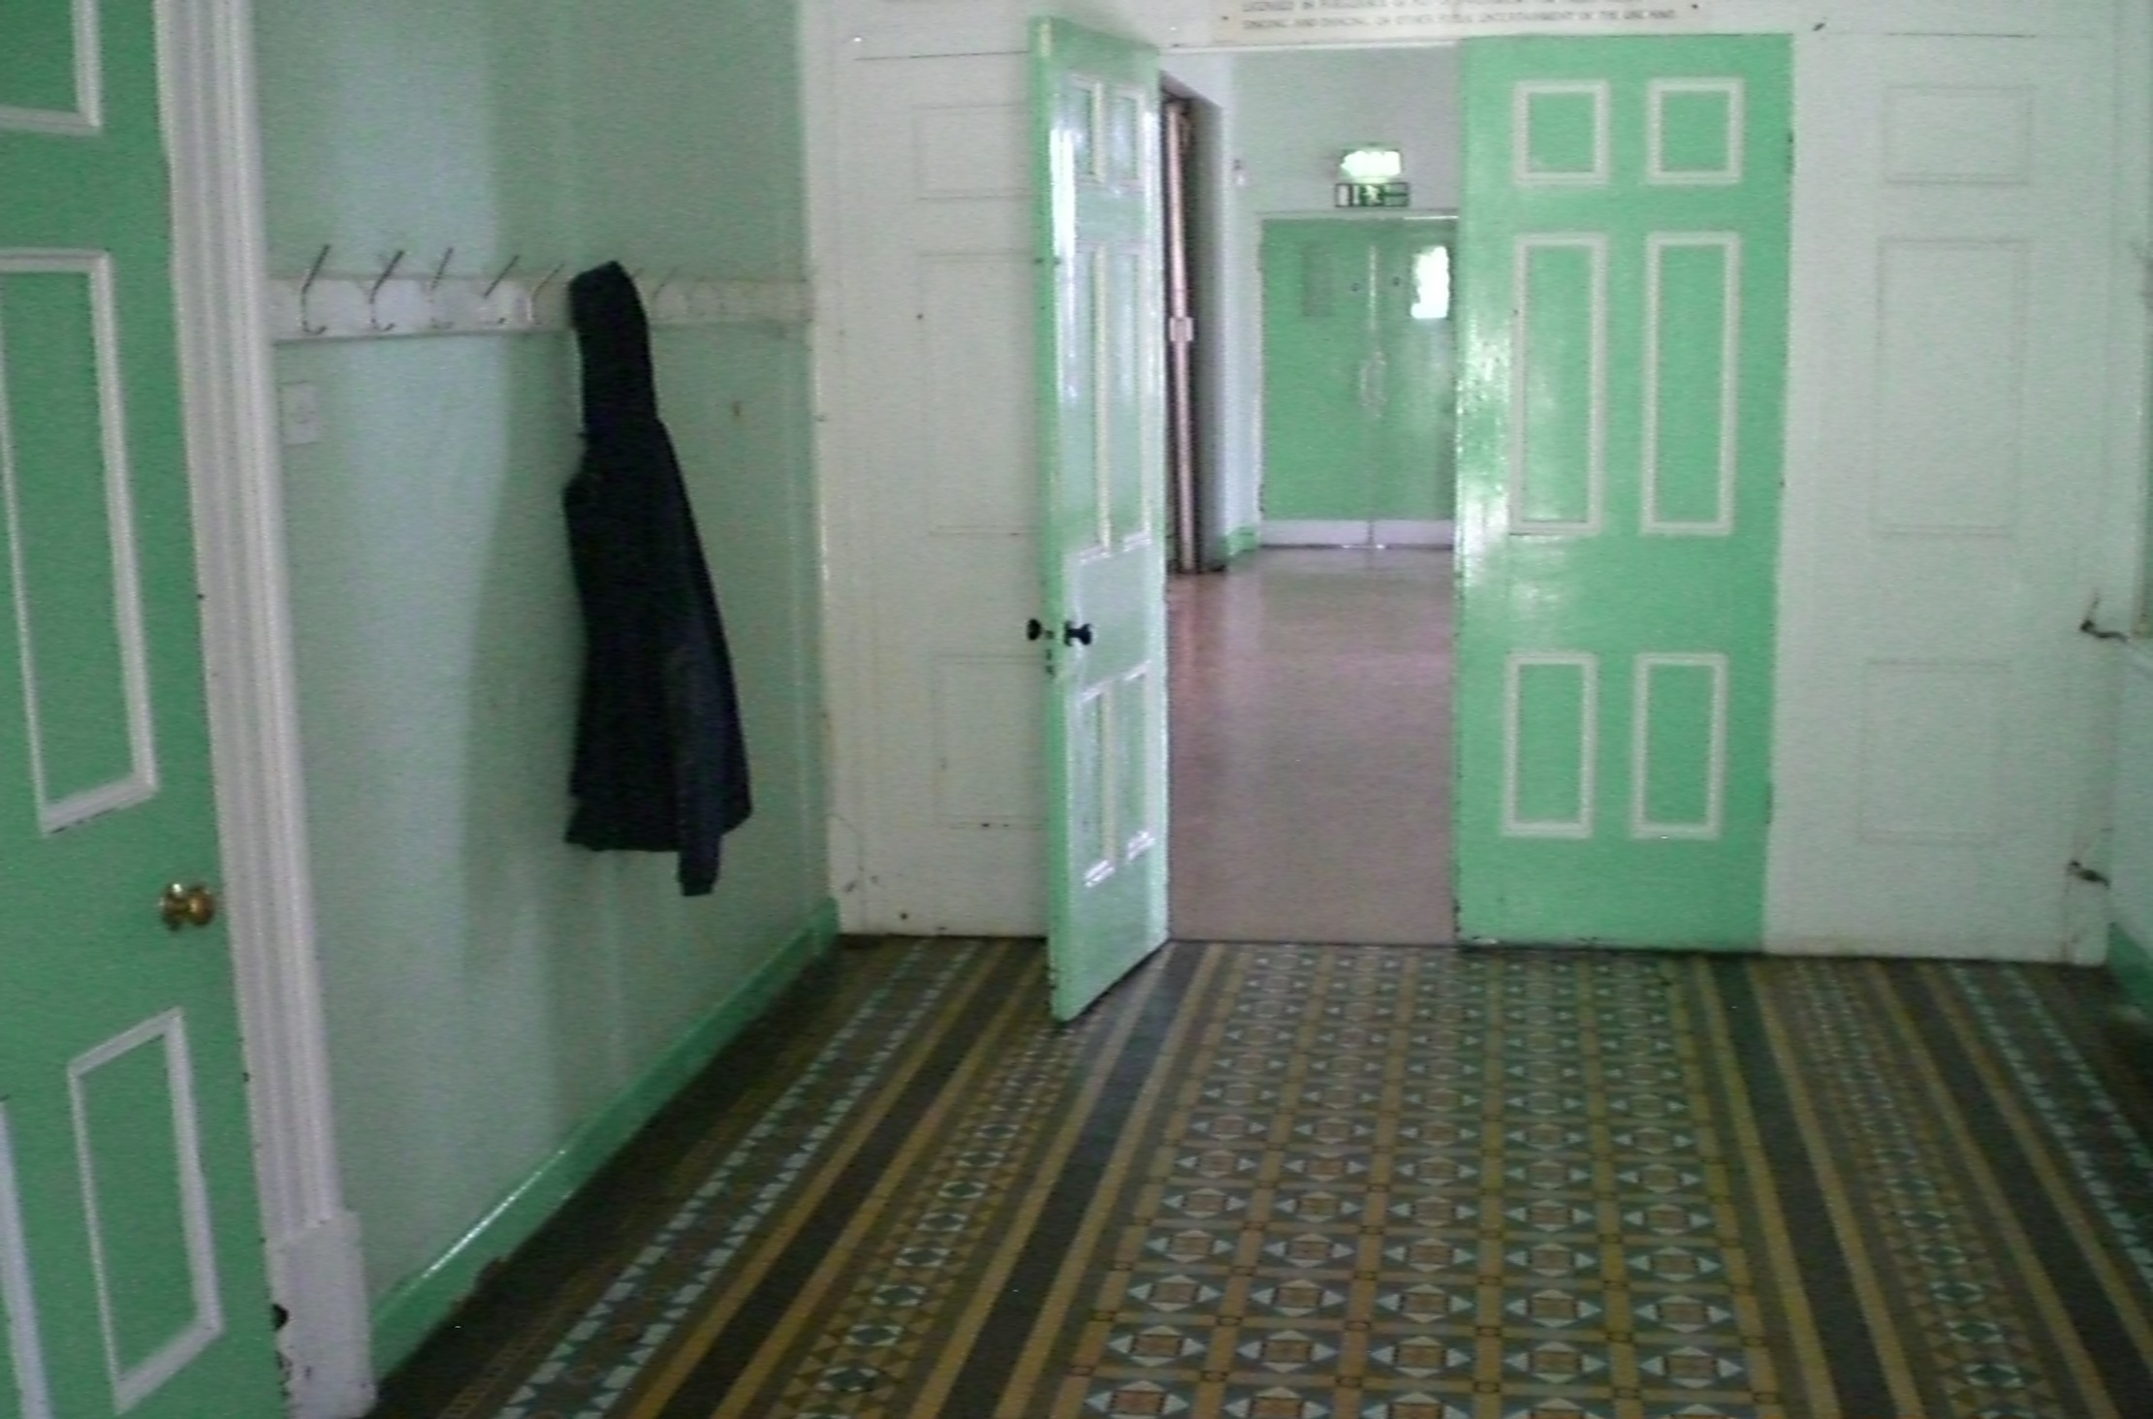
Just inside the front door showing the mosaic tiled floor

Slide 17
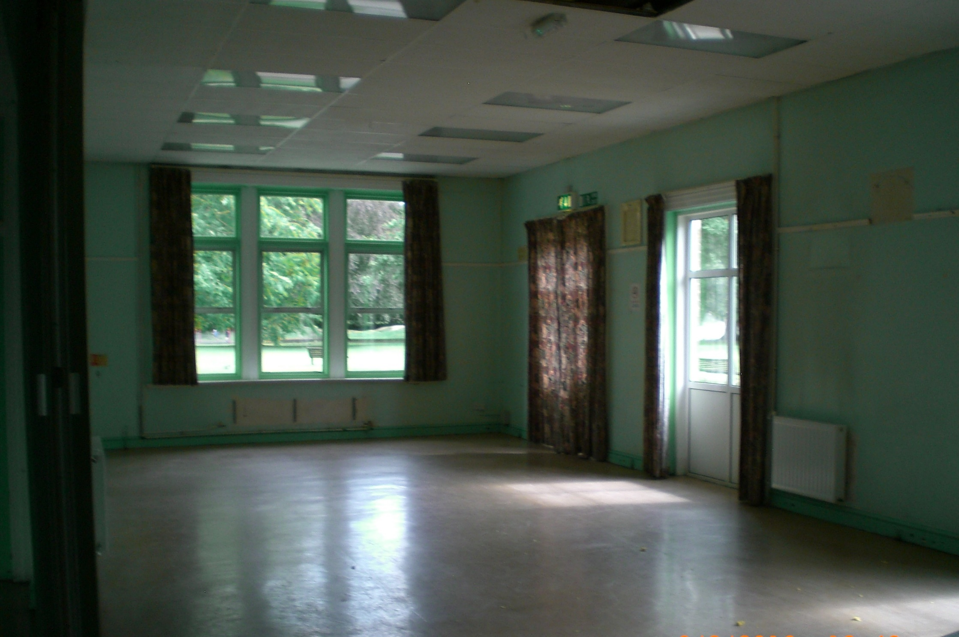
Part of one of the halls available for letting. This also had a moveable screen to divide it into two smaller rooms

Slide 18
Following discussions with East Cambs District Council and with Cambridgeshire Acre it became clear we would need to
prepare a business plan,
identify the fees required and
investigate what grant funding we might be able to access.
Also as the Pavilion is in a Conservation area English Heritage would need to be consulted

Slide 19
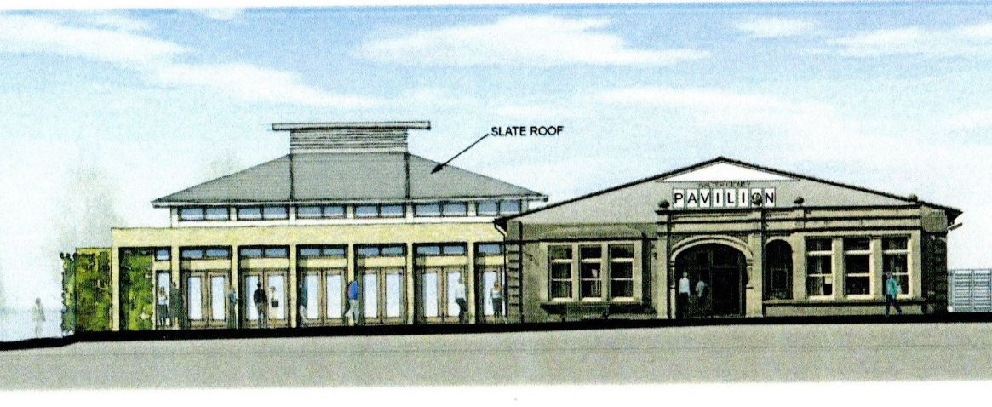
The Aspiration

Slide 20
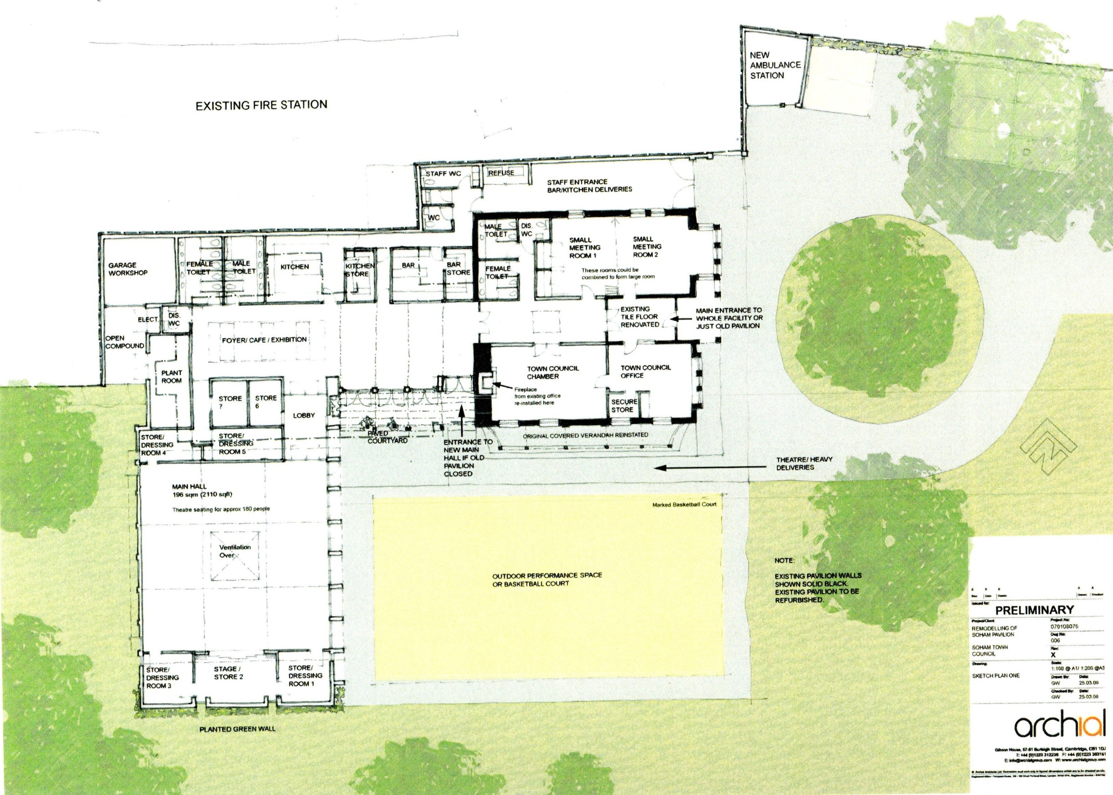
Plan showing the remodelling of the actual Pavilion and the addition of a new hall and car park

Slide 21
In anticipation of our building plans we had increased our precept by 2% in the previous year and so had some money in reserves to cover the estimated cost for pre-development fees

Slide 22
We discovered that our architect George Wright had retired but Archial had omitted to inform us.
They appointed a new architect to take over the project. Fortunately Darren Heffer is a local man and partly because of this we were prepared to accept his services.
Unfortunately this held up the progress of the project.

Slide 23
By mid 2011 Darren had familiarised himself with the project and suggested that he would improve the access and car parking.
He also suggested that we reinstate the curved veranda which had been there previously and echo the curve in the construction of the new hall roof.
We were also advised to clarify our VAT position. The VAT office informed us that the new build would not attract VAT but the refurbishment would. The Tax office were not prepared to say how much of the project would attract VAT until the project was finished.
This will make the final cost of the project very difficult to determine and will affect how much money we need to raise

Slide 24
By October 2011 we realised we would need to appoint various consultants in specialist areas
Arboriculture
Damp proofing
Drainage
Asbestos
Timber surveyor
structural engineer
Electrical and mechanical engineer
Quantity surveyor
Archaeological pits dug
These predevelopment costs would amount to around £30k

Slide 25
In March 2012, our architect announced he had been made redundant from Archial, but again we were never informed by them.
This further delayed our project because effectively all the plans etc were the property of the architect’s firm.

Slide 26
Fortunately Darren was soon re-employed with Saunders Boston.
He was able to negotiate with Archial because we had paid the full fees so they were prepared to release the plans to us.
Saunders Boston were happy for him to continue to work with our project

Slide 27
In March 2013 we presented the plans to the public at a public exhibition
They generally well received except for a few minor alterations which we agreed with.
Our plans were approved by ECDC planning committee in August 2013
At this stage the costs were £1.25million without furniture and excluding VAT

Slide 28
In 2013, because of the complicated world of grant funding, we decided to employ someone to look into what grant funding might be available. A business specialising in looking for grant funding was recommended to us. So we asked them to look carefully into any grants which we might be eligible for and asked them to report back in three months.
Unfortunately after three months they had nothing to report and still claimed their fees

Slide 29
Another business specialising in grants was more helpful but told us that as the whole grant funding world had changed we would only be eligible for small grants of up to £5000 for projects like kitchen fittings or furniture for a community room.
This was very disappointing news!

Slide 30
Cambridgeshire Acre reassured us that we could get a grant but would have to do another public consultation because the previous one (2008) was now out of date. This would mean more money would be needed.
We were not prepared to pay out more money on consultants with no guarantee that we would get funding.
By April 2014 it became increasingly obvious that we would be unable to raise the necessary £1.4 million for the project.

Slide 31
We considered a Public Works Loan whose repayment rates are very reasonable
But
it would mean saddling future administrations with a considerable debt
and
If we did sell our piece of land the loan could not be paid back earlier without a large penalty

Slide 32
So we were presented with three options:-
Proceed with a piecemeal project up to the value of the available funding
Have detailed discussions with Cambridgeshire Acre to secure the full funding
Abandon the project and just be content with minor improvements.

Slide 33
We were losing money from the loss in lettings income but were not prepared to abandon the project having spent so much on plans and consultants.
By January 2015 the estimated costs had risen to £1.7million
We had no alternative but to proceed with a much curtailed project.
Darren Heffer suggested we proceed with the refurbishment of the main building and the improvements to the access and car parking and put the new hall on hold for now.
He and the quantity surveyor undertook to provide revamped drawings and estimates for the changed project.

Slide 34
By December 2015 the Council had agreed to the revised project and Saunders Boston had produced a new brief to be sent out when adverts for tenders were published in February 2016
The estimate for this part of the project Phase One was just over £560K
The plans for the revised project were passed in May 2016

Slide 35
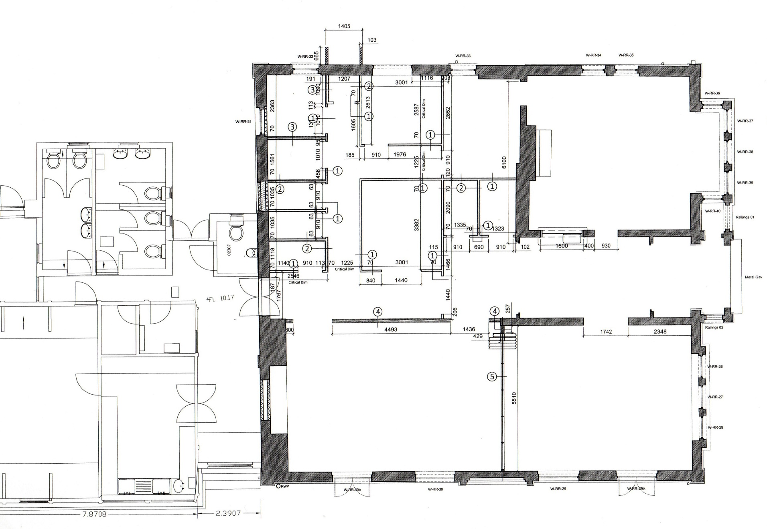
Plan showing remodelled main building and the rear part left untouched

Slide 36
The Council decided that any money it received from CIL for the next three years would be transferred immediately into reserves to top them up.
At the same time it came to light that the Town Council was already registered for VAT so we will be able to reclaim any VAT charged on the work provided that we undertake to charge VAT on future bookings for rooms.

Slide 37
Tenders were determined by July 2016 and the contractors were Godfrey Hicks whose estimate came to approx £600K
Discussions with East Cambs District Council provided us with the opportunity to draw down £585K from their Section 106 fund which together with our reserves enabled us to provide sufficient funds. Without this offer we would not have been able to proceed as we had already paid £80K in predevelopment costs.
This wonderful news meant that the project could finally go ahead

Slide 38
Work was due to start at the beginning of October 2016 and before that we had to move the office and its equipment into the ‘back room’, where we had to install some additional heating for our staff. In fact the office was only shut for 2 days
Once work was underway there were other problems some small and easily solved but some not so small

Slide 39
The planned new windows for the front were found not to be suitable for the stone surrounds so new ones had to be commissioned
The floor coverings agreed for the Council Chamber were not thought suitable for public rooms so we chose some vinyl instead
We had to dispose of a very large oak table which had been in the council chamber
The new access and car park due to be asphalted, could not be effectively drained without a very expensive drain across the Recreation Ground so we settled for a paved road and car park instead
Problems with undiscovered asbestos and a bees nest in the roof!

Slide 40
The final cost of the project was £618K and it came in with only £32K over the budget. This was just under 5% over budget.
£24K was taken up because we were forced to provide overnight security for the weeks that the contractor’s machinery was on site because of the high level of anti social behaviour we suffered
Given that we were pleased to have managed to complete the project so nearly within our budget.

Slide 41
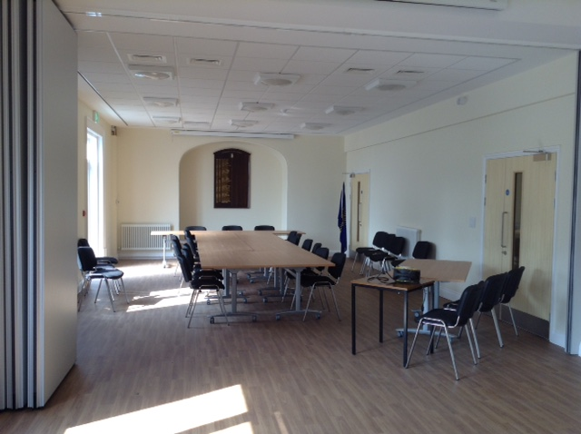
Remodelled hall now being used as our Council Chamber. It also a room divider to it can be hired as two smaller rooms

Slide 42
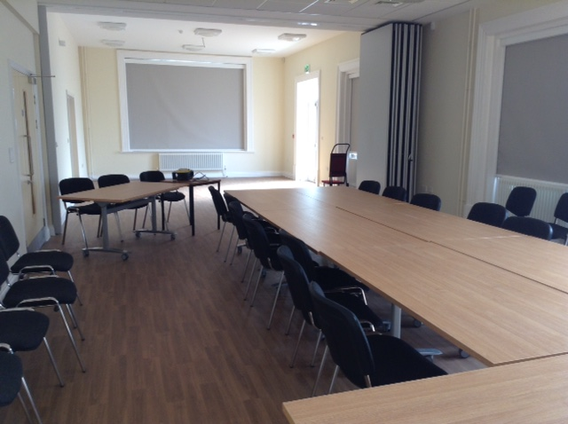
This now has full facilities for TV and projection and for people who are hard of hearing

Slide 43
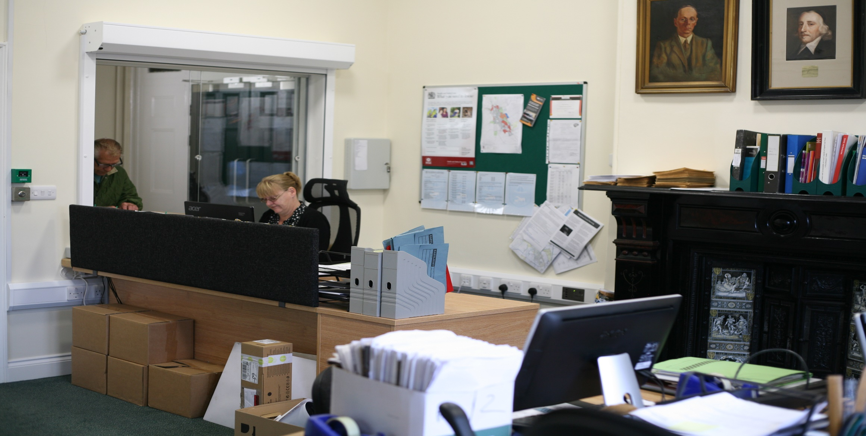
Refurbished council office with several work stations that councillors can use. The old tiled fireplace has been kept as a feature.

Slide 44
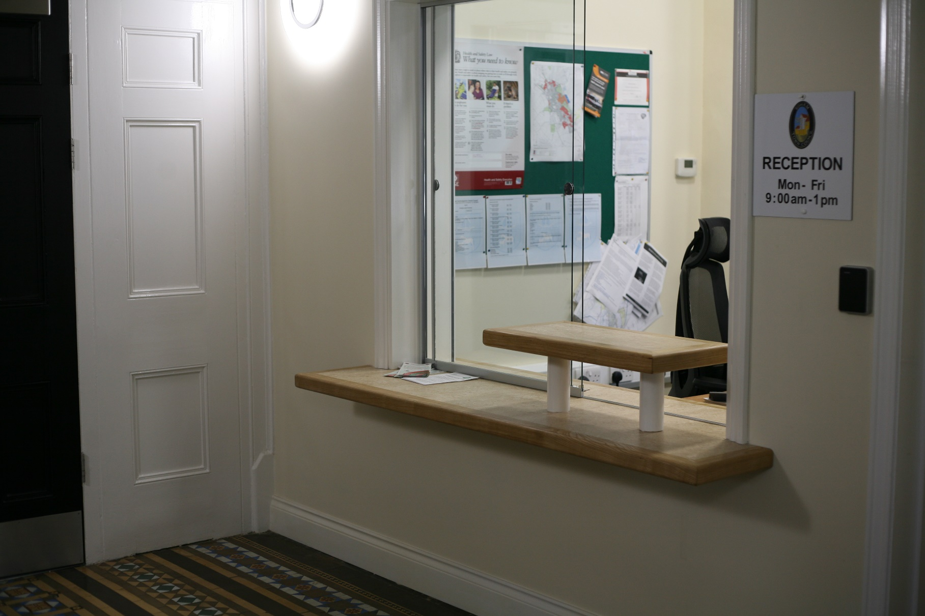
Refurbished foyer with new reception area which provides the staff with a safer place when dealing with members of the public. The lovely mosaic floor has been retained.

Slide 45
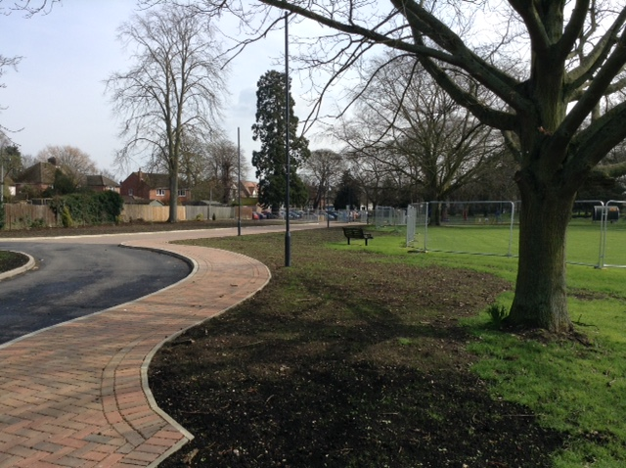
New safer access now includes a separate access for pedestrians and vehicles both of which are fully lit

Slide 46
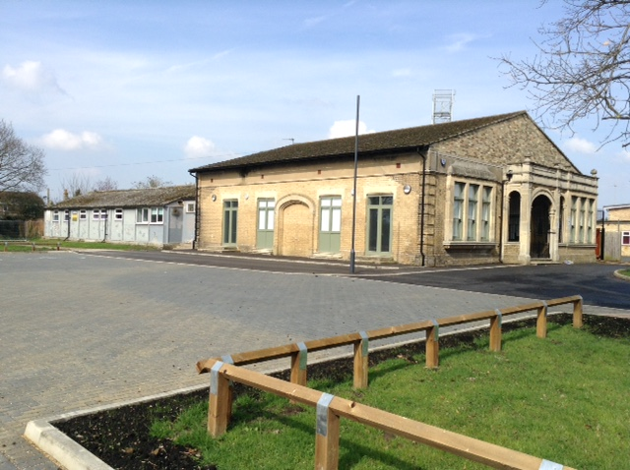
No change to the outside of the Pavilion but the car park has been resurfaced and extended

Slide 47
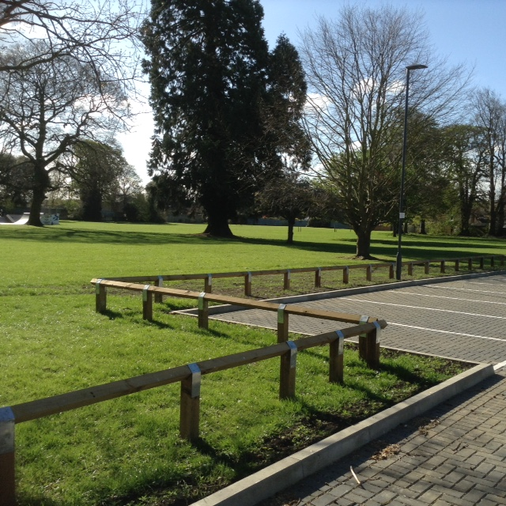
Edge of new car park with safety fencing

Slide 48
Despite all the problems and hold ups, and the difficulties our staff had to live with, the project was finally completed and we moved into our newly refurbished building in March 2017. We held our first Town Council meeting in the new Council Chamber in April 2017.
Since then we have had to have various amendments or additions sorted out including the addition of a hearing loop which had been omitted and the need to have a new projector because the one originally installed was not up to the standard stipulated.

Slide 49
Everyone is delighted with the result and are now taking more bookings. We also have Citizens Advice Bureau and Poss+Ability using rooms regularly providing a service to the community.
We have learnt a lot from this project and we hope it will help with Phase Two, which will be the building of the new hall which we hope to get started on soon but we will first need to be sure that we have sufficient funds.

Slide 50
Thank you
Any Questions?

