Slide 1
Sutton Parish Council
The Glebe Community Centre Car Park & Driveway refurbishment

Slide 2
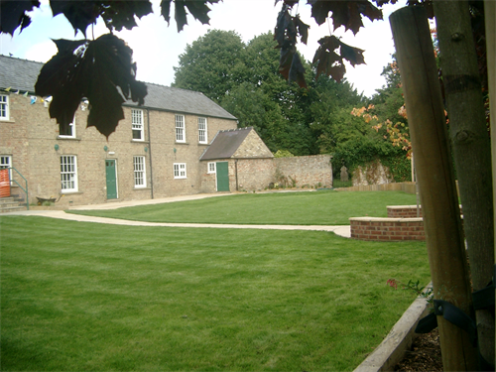
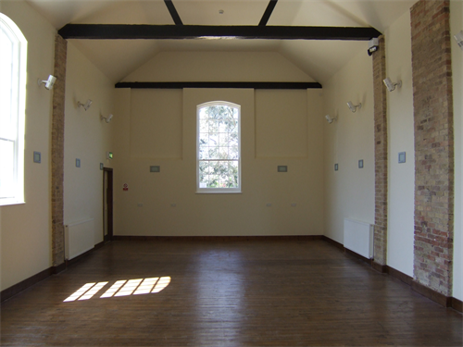
The Glebe: The Background
In 2006 purchased and refurbished the old church hall and cottage
Created a new village community centre
A well used major addition to village facilities
Hosts the Parish Office, a large hall & meeting rooms

Slide 3
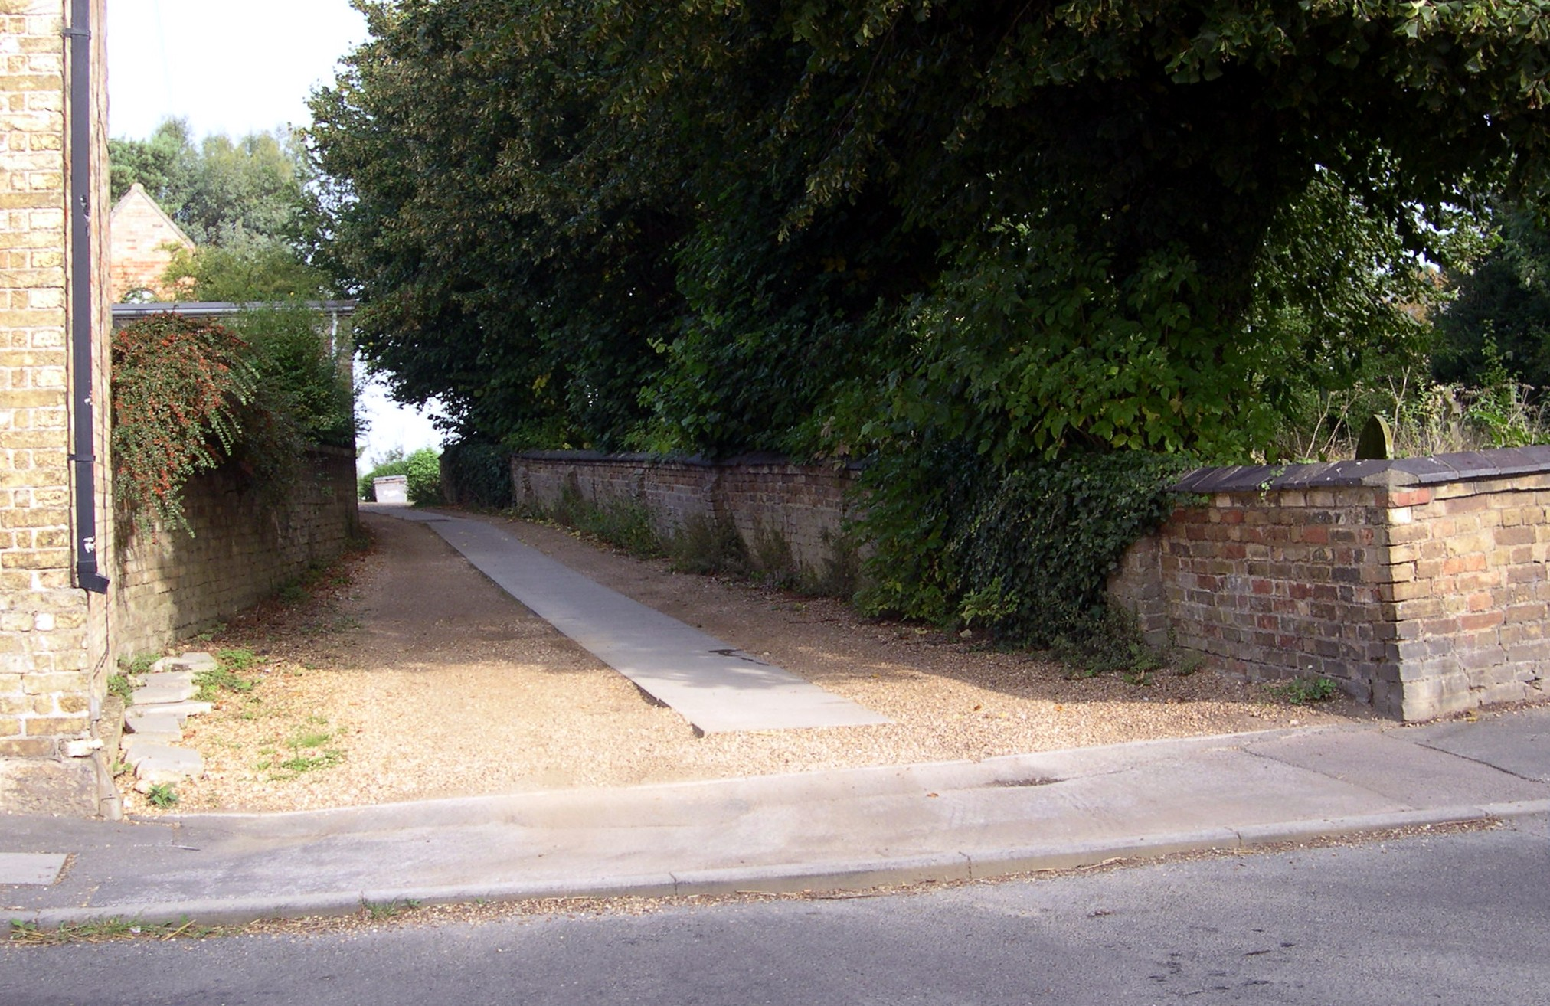
The Driveway and Car Park
Funding did not allow for upgrading the external facilities, including the driveway and carpark
Driveway provides access to the Glebe and the parish burial ground with a car park for users
Heavily used on a daily basis but becoming increasing unsuitable
Car parking area is restricted

Slide 4
Key Issues to Address
Gravel driveway unsuitable for regular use
Access difficulties for wheel chair users and push chairs
Boundary wall bowing and starting to collapse becoming unsafe
Car parking area not able to be fully utilised
No night time lighting for pedestrians
Issues with underground drains and tree roots

Slide 5
The Plan

Slide 6
The Challenges
Located in the village conservation area
Planning application needed to be submitted
Agreement and consent for tree works
Approval from C of E Diocesan board required
Tendering of works and selection of suitable contractors
Needed to establish a funding package

Slide 7
The Timetable
Date | Action
June 2014 | Planning application submitted to ECDC
August 2014 | Planning permission granted by ECDC
September 2014 | Letter of intent for faculty sent to Diocesan board
June 2016 | Application for private faculty made
August 2016 | Application for tree works and consent
August 2016 | Application for grant (S106)
September 2016 | Tendering of the contract
October 2016 | Grant confirmed and contract awarded
November 2016 | Work on drive and car park begins
February 2017 | Work completed, new driveway and car park open

Slide 8
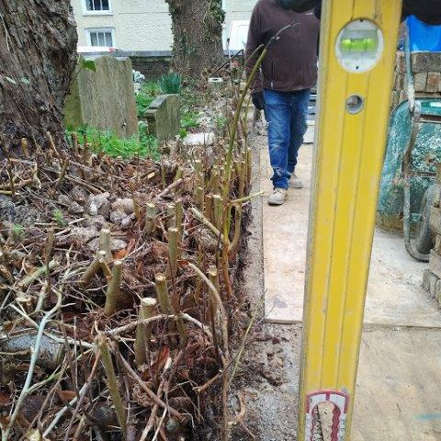
The Costs and Funding
Total cost: £78,486.81
ECDC Section 106 grant: £71,241.79 (Community Infrastructure)
Parish Council Capital: £1,940.61
Parish Council reserves: £5,304.41

Slide 9
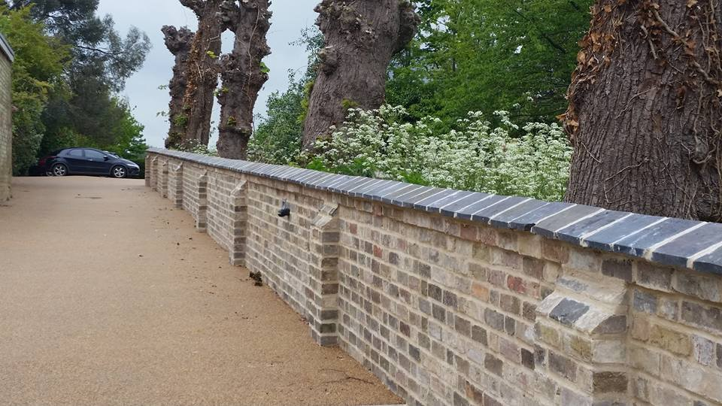
The Result
A high quality surfaced driveway and much improved more spacious car park
A rebuilt boundary wall in front of pollarded and tidied trees
Sensor switched night lighting
A great result for Glebe users

